Slide 1


Deep Learning with Big Data 5.8.23
Final Project
Veronica Morales

Slide 2
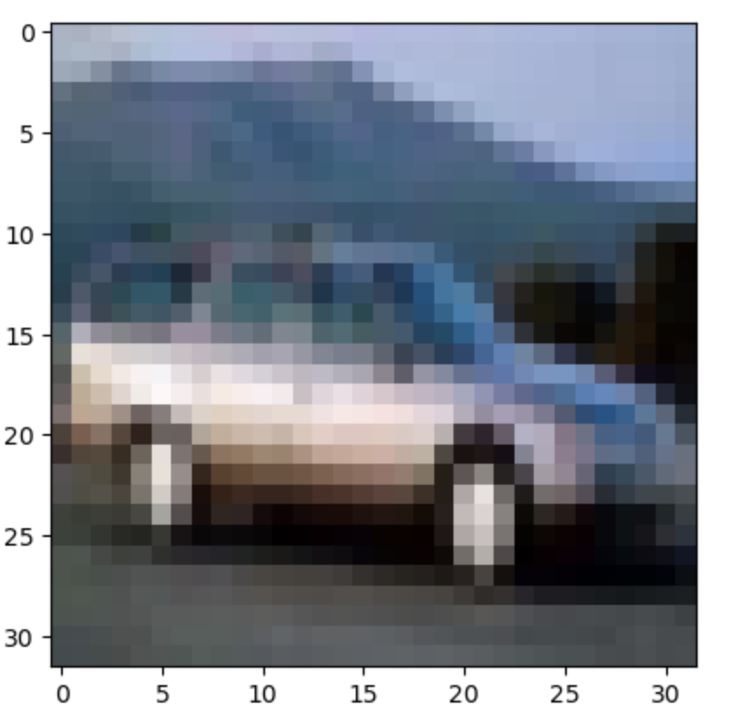
Final Project Introduction
Part I: Use TensorFlow Directly in Coding
Part II: A Dataset of Images or Audio Files
Part III: Obtain the Cifar-10 Dataset
Part IV: Build, Train, and Test CNN on CIFAR-10 Dataset
Part V: Compare CNN Performance
Part VI: Improve CNN Performance

Slide 3





Part I: Use TensorFlow Directly in Coding Question 1: Question 2:
Question 1.1: Is the student required to use TensorFlow directly in coding (build, train, and test CNN) in this homework assignment?
Answer: Yes, we are required to build, train, and test our CNNs using TensorFlow.
Question 1.2: Should the student use Keras in coding (build, train, and test CNN) in this homework assignment?
Answer: No, Keras is only used in the first half of the semester and for the midterm. Only TensorFlow is acceptable or this assignment.
23.27% higher than
Human OTC

Slide 4
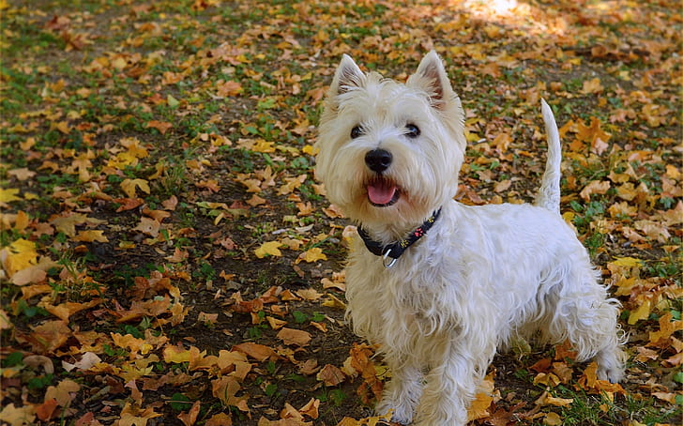
Part II: A Dataset of Images or Audio Files
Stanford Dog Dataset
This dataset consists of 20,580 images within 120 categories of dog breeds.
There are approximately 150 images per dog bread.
Formulated for fine-grained image categorization
Good candidate for creating a Convolutional Neural Network

Slide 5
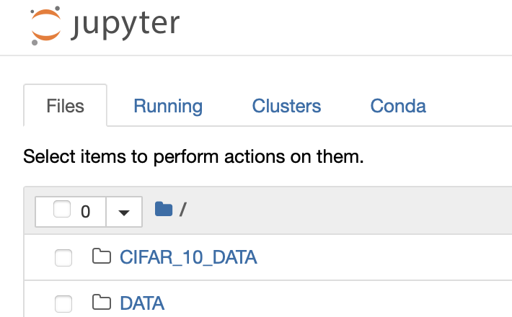
Part III: Obtain the Cifar-10 Dataset
Cifar-10 Dataset uploaded using the SSH terminal accessed through the Google Cloud Console
Created a new subfolder in the Jupyter directory
Named the directory Cifar-10 Dataset and copied the dataset into the subfolder
The dataset then appeared in the Jupyter Homepage in the folder.

Slide 6
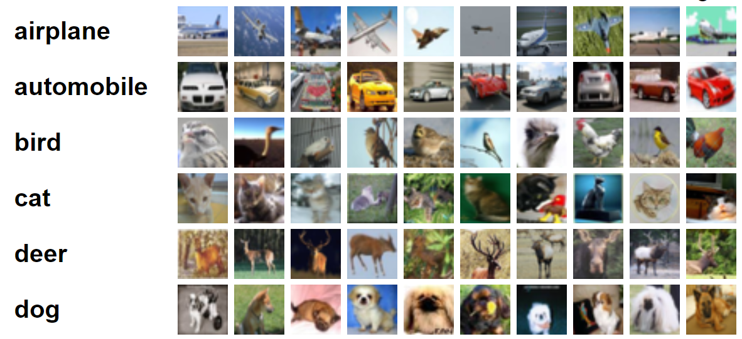
Part IV: Build, Train, and Test CNN on CIFAR-10 Dataset
2-Layered Convolution Neural Network

Slide 7
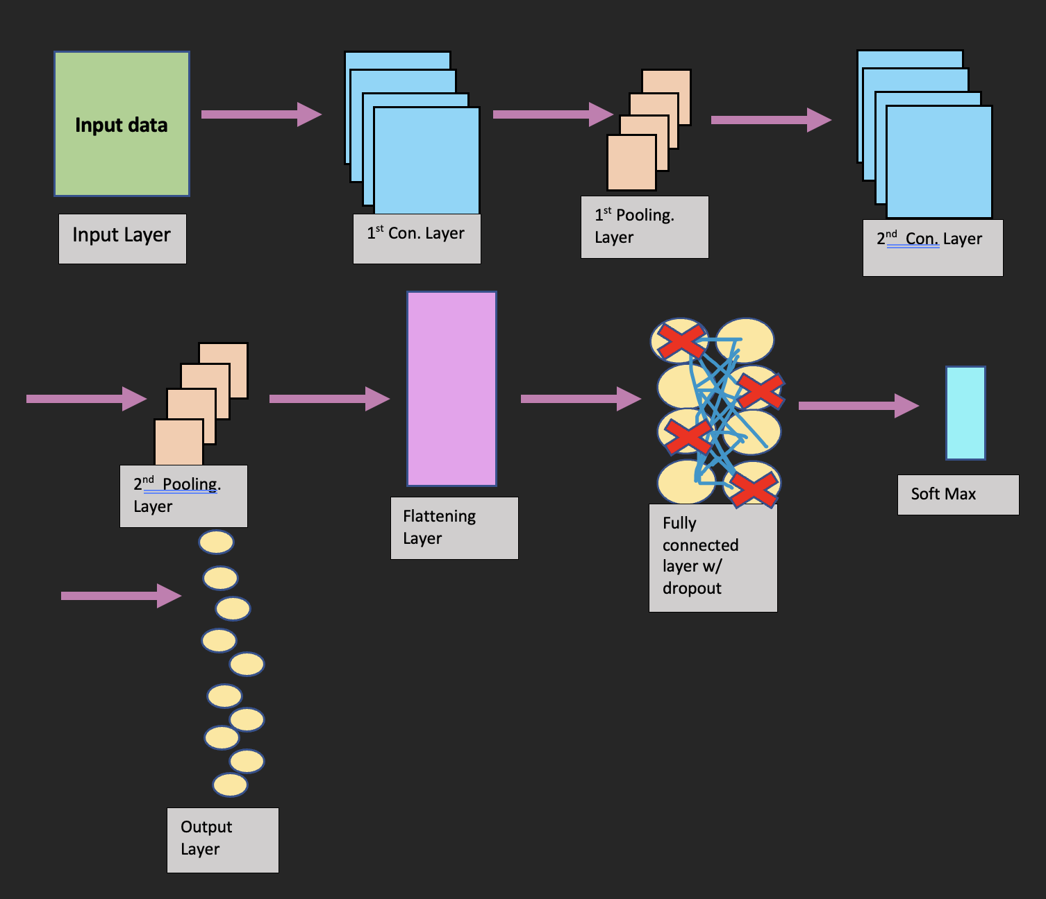

Diagram of the Network Architecture

Slide 8
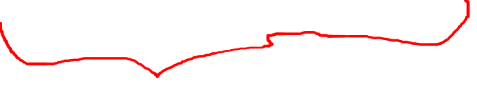
Diagram of the Network Architecture
Input Layer:
The input data set includes the training set, the test set, and labels. The Cifar_10 dataset consists of images that are 32x32x3 in size which amounts 3072 pixels/weights.
First Convolutional Layer
The First Convolutional Layer extracts the features of the data by performing 2D convolution and then passing through a RELU activation function and then a bias term is added to the function.
1st Pooling Layer
The purpose of this layer, the pooling layer, is to reduce the dimensions of the input. The confine of the pooling layer is defined by the max-pool function which condenses the input layer to a 2x2 dimension. The pooling layer is important because it helps simplify the computational complexity of the neural network.

Slide 9
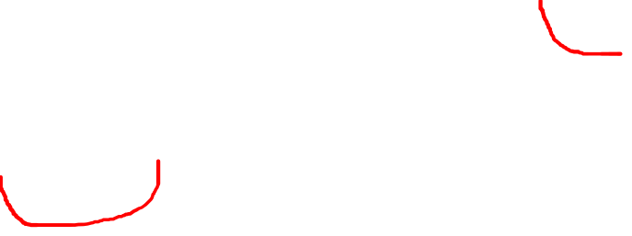
Diagram of the Network Architecture (cont.)
Second Convolutional Layer
The purpose of the second convolutional layer is to further extract features from the last layers inputs. This layer increases the depth of the neural network which ultimately increases the accuracy of the classification tasks.
Second Pooling Layer
The second pooling layer has the same purpose as the first pooling layer which is to reduce the dimensions of the input.

Slide 10
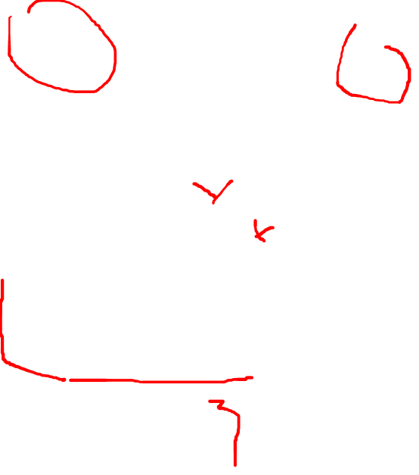
Diagram of the Network Architecture (cont.)
Flattening Layer
The reshape/flattening layer is used to reshape the output data from the previous pooling layer. The multi-dimensional data are flattened into one-dimensional data. The data will now have a vector shape instead of a mult-dimensional shape.
Fully Connected Layer and Dropout Layer
One of the unique features of a CNN is that is composed to two different architectures, the convolutional layers and the fully connected layers which are featured in multi-layered neural networks. The purpose of the fully connected layer is to take the output of the flattening layer and apply a linear transformation to it in order to observe non-linear relationships.
In the drop-out layer function, some of the neurons are randomly dropped to prevent overfitting.

Slide 11

Diagram of the Network Architecture (cont.)
Output Layer and SoftMax :
The output layer is the last layer in the neural network that produces the binary outcomes. In this neural network, there are 10 classifications which are defined on the code below. The 10 classifications in this neural model were defined in the input layer.
The SoftMax function calculates the loss value which indicates the closeness between training labels.

Slide 12
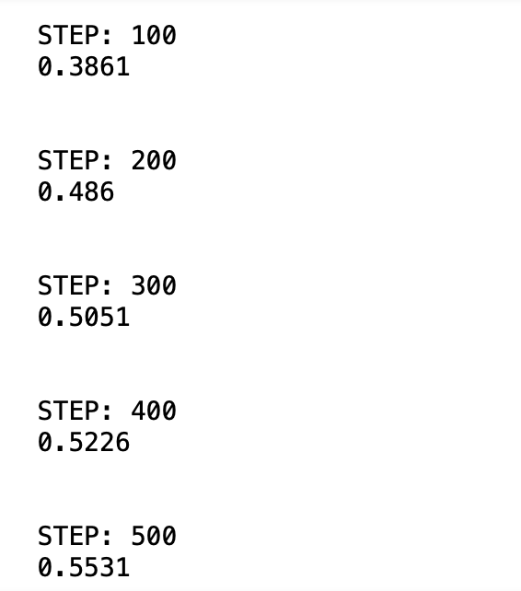
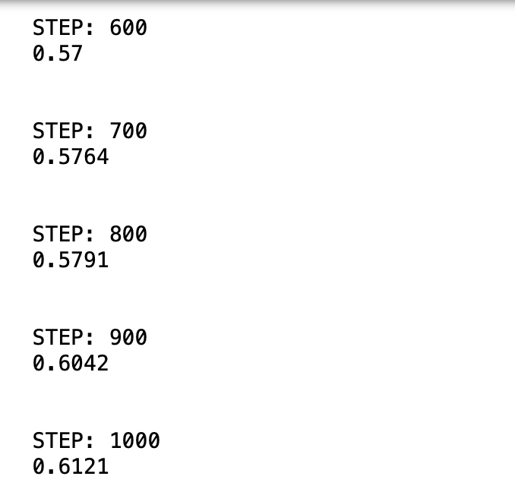
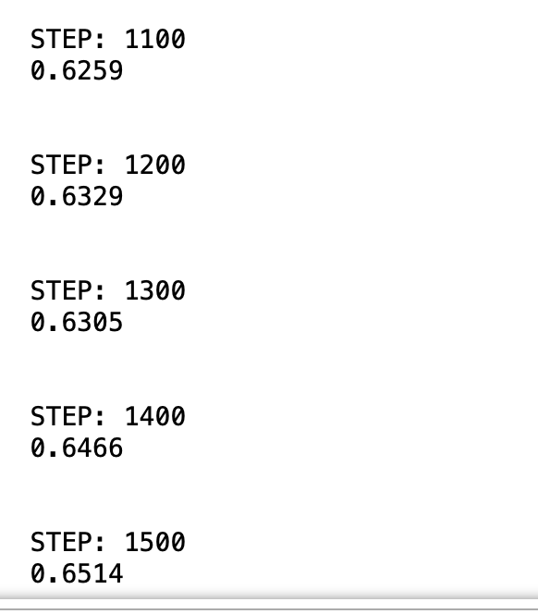
CIFAR_10 CNN Results and Report:
The initial accuracy result at Step 100 is at 39%. In the last few neural networks designed in the class, low scores in the early steps is not uncommon. By step 500, the accuracy score has jumped up to 0.55% which is fairly low.
The accuracy score climbs about 0.05% per 100 steps, reaching 60% by step 900.
The accuracy scores start to get interesting when we reach step 1200 at 63% because the accuracy score drops very slightly at 1300 and then climbs back up.

Slide 13
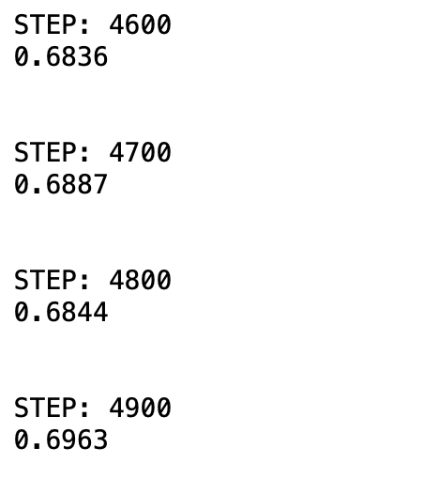
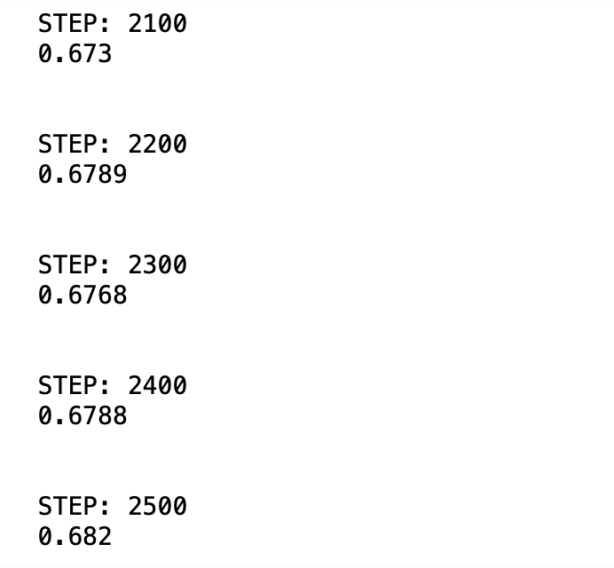
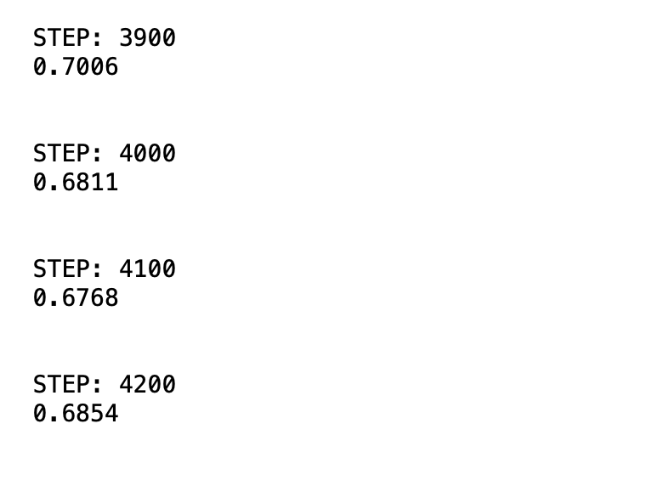
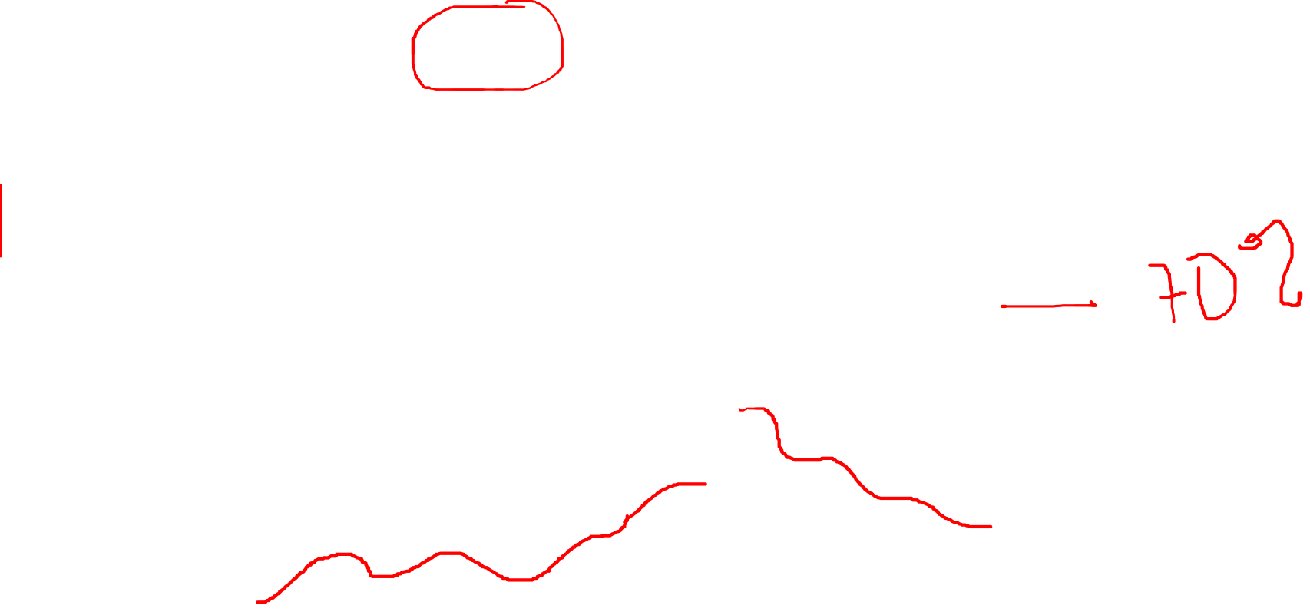
Results and Results Report (continued):
The pattern reaches its max accuracy at 3900 with an accuracy score of 70% and then begins to steadily drop in the next steps.
The final step 4900 finishes with an accuracy score of .6963 which is low.
By this point, there’s an interesting trend with the accuracy score going up and down in kind of a wave-like pattern.

Slide 14
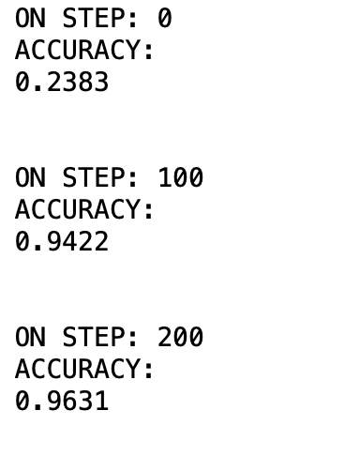
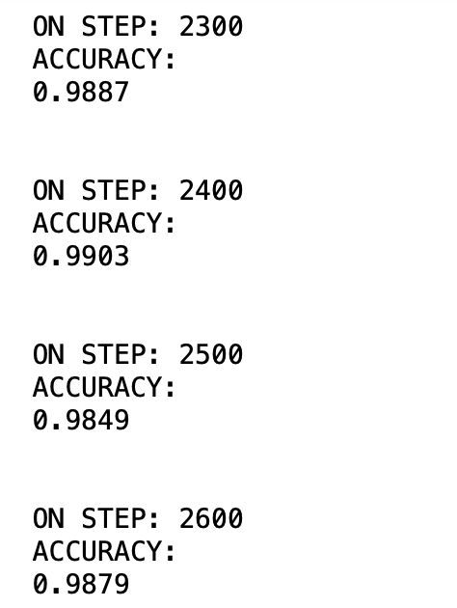
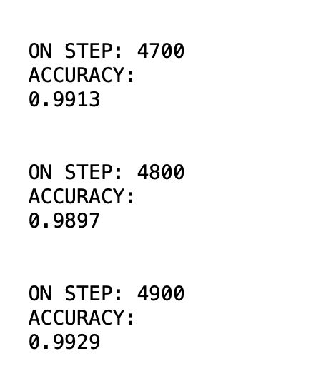
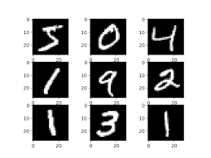
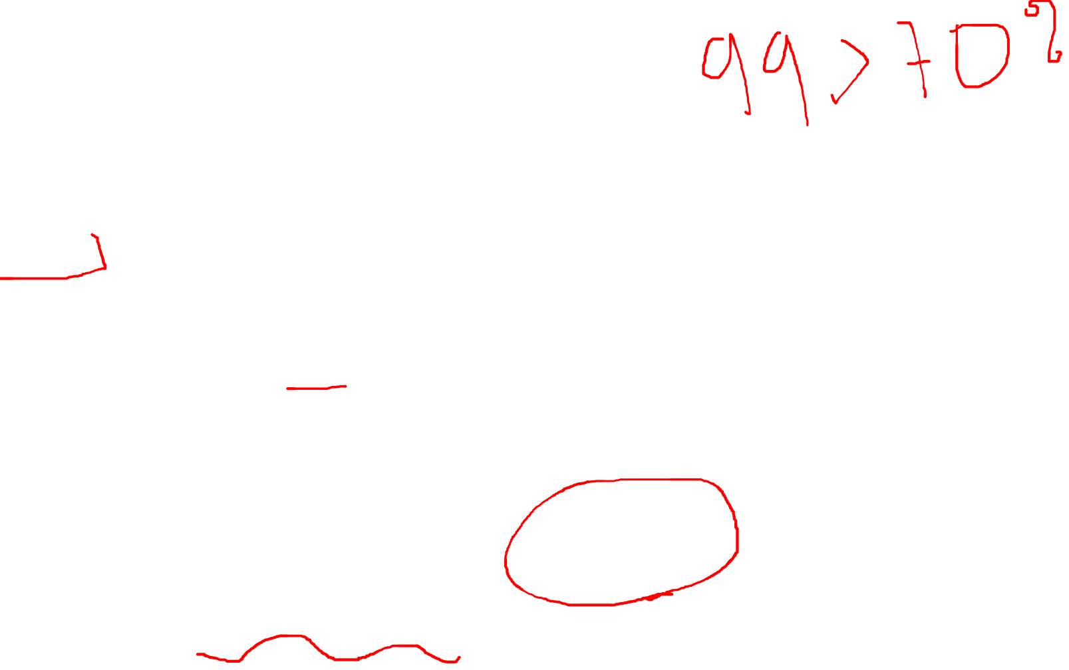
PART V: Compare CNN Performance MNIST Data CNN Results:

Slide 15
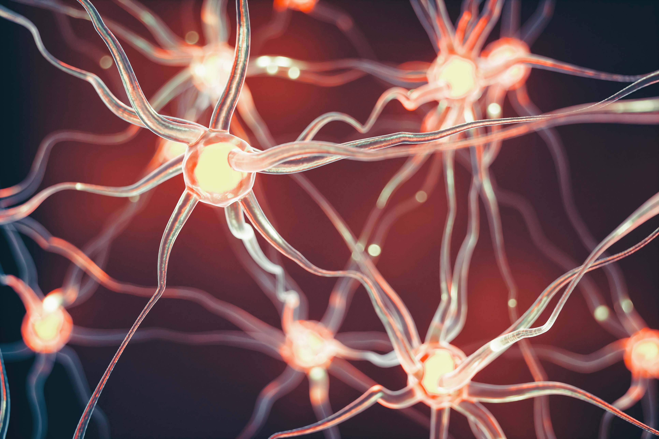
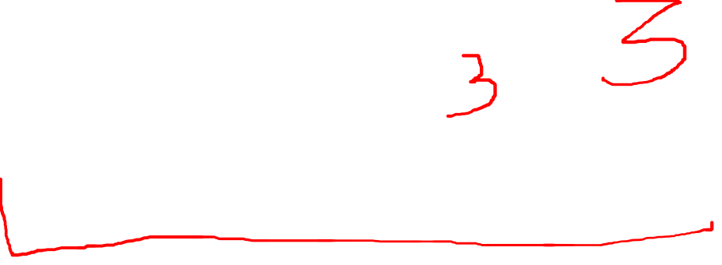
PART VI: Improve CNN Performance:
Improvement Proposal:
The highest accuracy score for the CNN was 70%.
Goal is to improve score by ten point to bring the accuracy score to at least 80%.
Improve the accuracy and functionality of this CNN.
Add one more convolutional layer.
Add one more pooling layer
a deeper neural network should produce better results

Slide 16
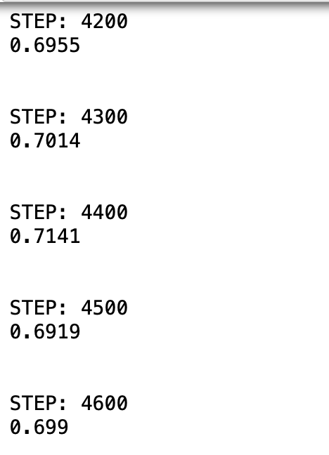

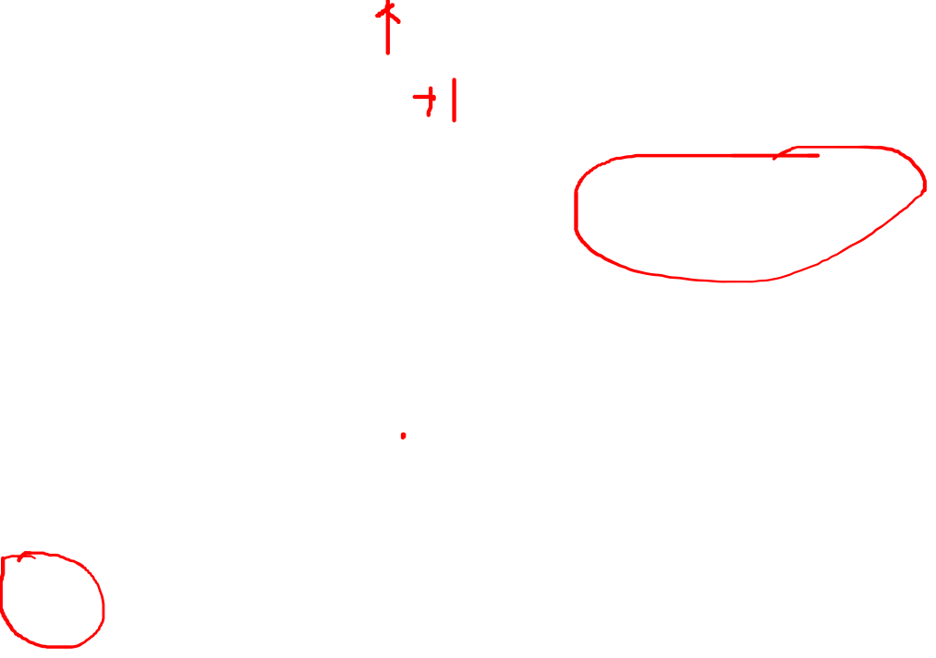
Updated CNN Results Report:
Good News: Score was improved
Bad News: Score was improved by 1 point
First CIFAR_10 CNN accuracy score: 70%
Updated CIFAR_10 CNN accuracy score: 71%
Continued to alter CNN after first attempt
Tried raising the learning rate
Tried lowering the learning rate
Tried changing the batches
Couldn’t get a score higher than 71%

Slide 17
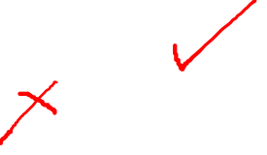
Conclusion
Part I: Use TensorFlow Directly in Coding
Use TensorFlow AI Framework
Do not use Keras
Part II: A Dataset of Images or Audio File
Stanford Dogs data set
Images of 120 categories of dog breeds
Great for Classification exercise and CNN models
Part III: Obtain the Cifar-10 Dataset
Load to SSH
Create new subfolder in Jupyter
Copy to sub folder

Slide 18


Conclusion (continued)
Part IV: Build, Train, and Test CNN on CIFAR-10 Dataset
2 convolutional layers
5,000 steps and 100 steps of training
Accuracy score of 70%
Part V: Compare CNN Performance
Mnist CNN accuracy score: 99%
CIFAR_10 CNN accuracy score 70%
Part VI: Improve CNN Performance
Added a third convolutional layer
Added a third pooling layer
Accuracy score of 71%

Slide 19

The END

